Slide 1
Estimating pose and locating keypoints
Jitendra Malik

Slide 2
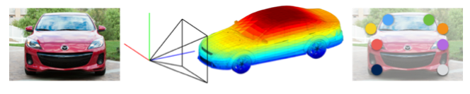
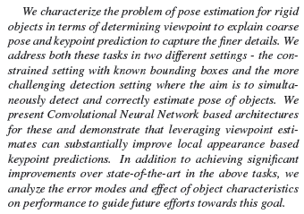
Viewpoints and Keypoints
- Shubham Tulsiani, Jitendra Malik

Slide 3
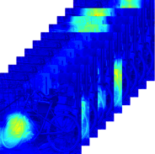

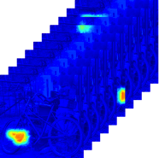
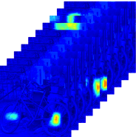
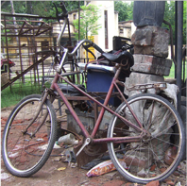
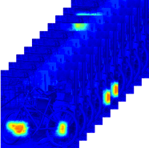
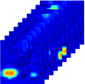

Overview
Viewpoint Conditioned
Keypoint Log-Likelihood
Viewpoint Prediction
+
Keypoint Likelihood
+
Appearance based
Keypoint Log-Likelihood
Multiscale Convolutional
Keypoint Response Maps

Slide 4
Viewpoint Prediction
Viewpoint is described by elevation, azimuth and cyclorotation
For each angle, the problem is treated as a classification among fixed bins
We train a VGG based CNN where fc-8 does predicts the bin for each euler angle
Some tricks used to jointly train a network for all classes (loss computed only on class specific fc8 units)

Slide 5

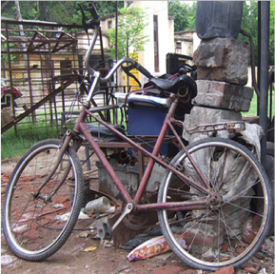
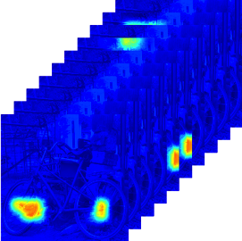

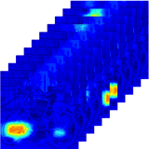
Keypoint Prediction :
Convolutional Responses
12 X 12 response map
416 X 416 image
+
12 X 12 response map
224 X 224 image
6 X 6 response map

Slide 6

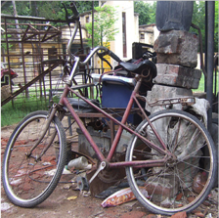
Keypoint Prediction :
Viewpoint Based Prior
The viewpoint based location prior is computed using keypoint locations of training instances with similar views

Slide 7
Examples : Viewpoint Prediction
The columns show 15th, 30th, 45th, 60th, 75th and 90th percentile instances in terms of the error.

Slide 8
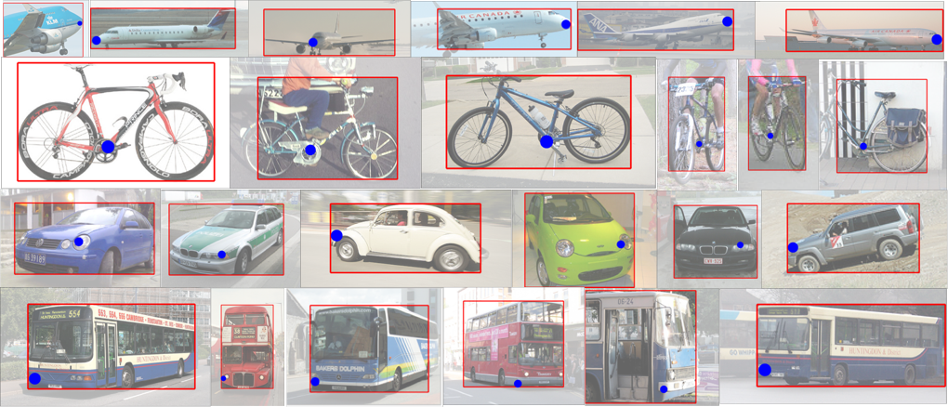
Examples : Keypoint Prediction
Visualization of keypoints predicted in the detection setting. We sort the keypoints detections by their prediction score and visualize every 15th detection for ’Nosetip’ of aeroplanes, ’Left Headlight’ of cars, ’Crankcentre’ of bicycles and ‘Left Base’ of buses.

Slide 9
Results : Viewpoint Prediction
Viewpoint Prediction (known bounding box)
Viewpoint Prediction (detection setting)

Slide 10
Results : Keypoint Prediction
Keypoint Localization (known bounding box)
Keypoint Detection (no bounding box)

Slide 11
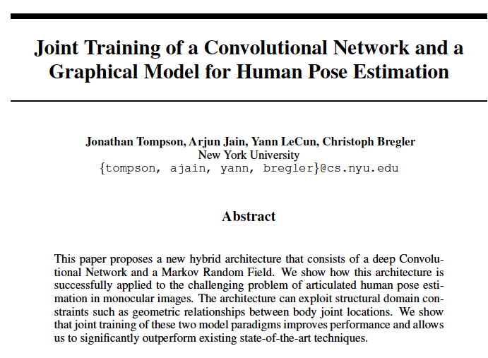

Slide 12
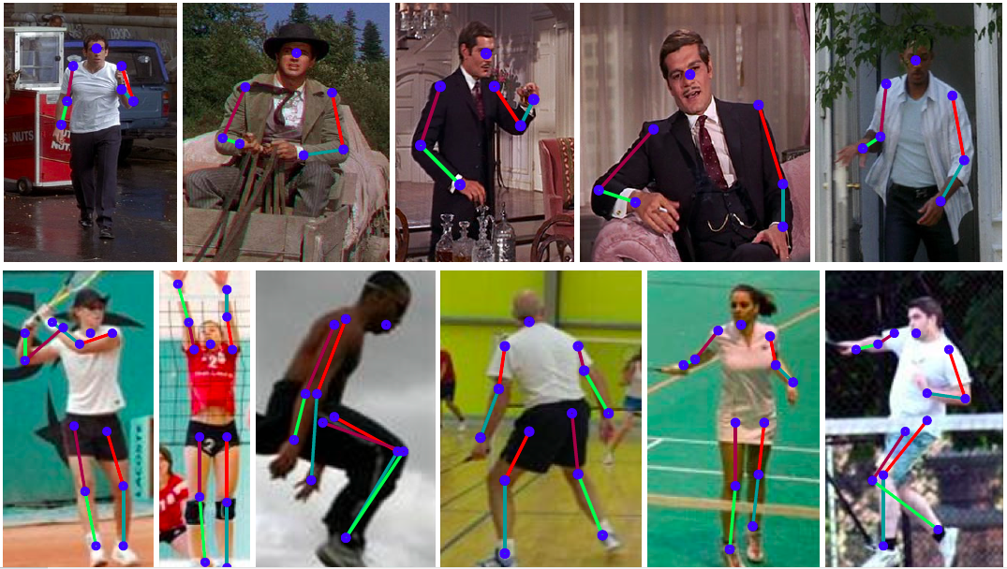

Slide 13
Key ideas
Convolutional net based part detector predicts heat maps for keypoints.
Use these as unary potentials for a MRF with binary potentials that constrain joint inter-connectivity and global pose consistency (e.g. a face detector peak should not be very far from a shoulder detector peak)

Slide 14
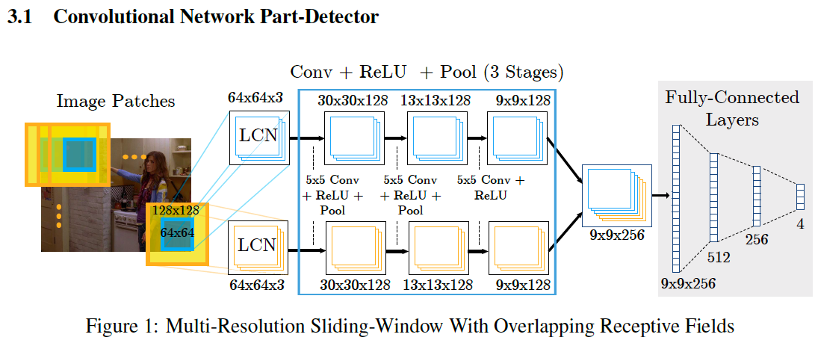

Slide 15
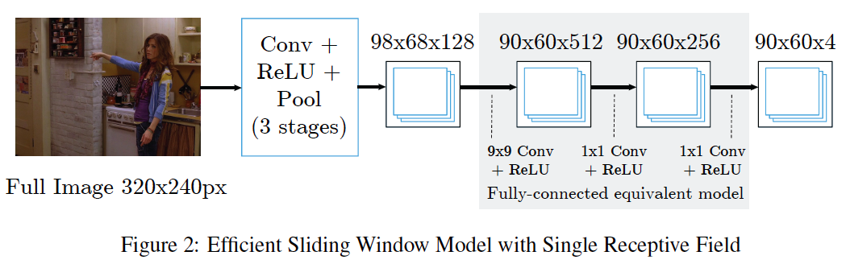

Slide 16
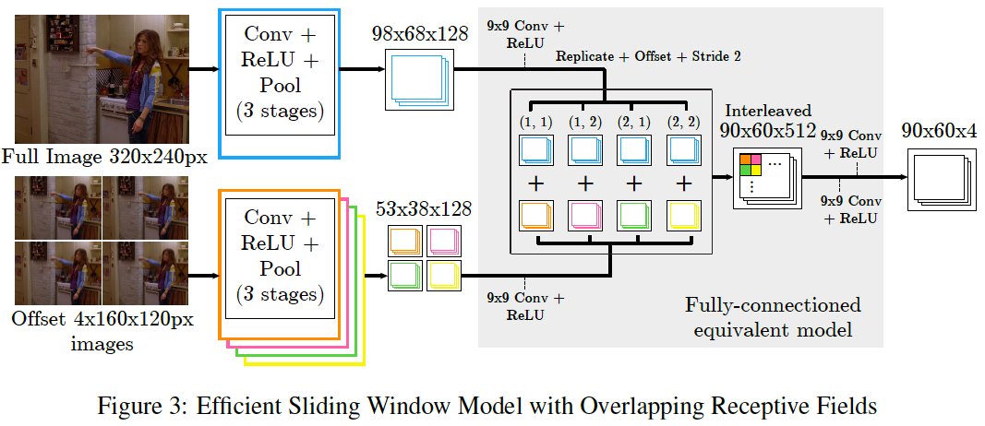

Slide 17
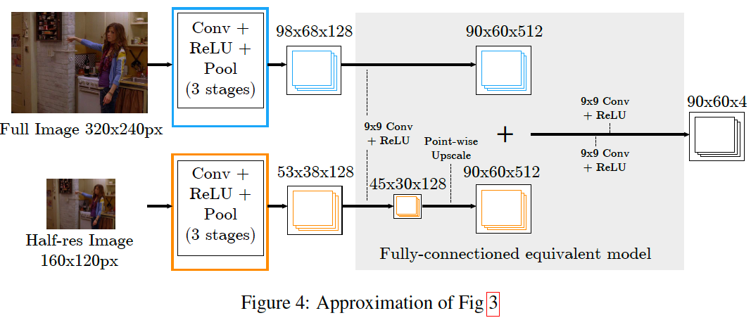

Slide 18
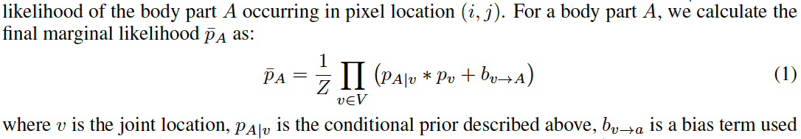
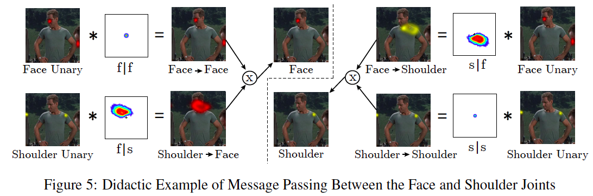
Convolutional priors

Slide 19
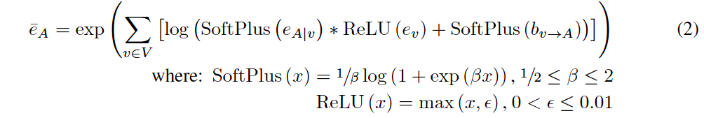
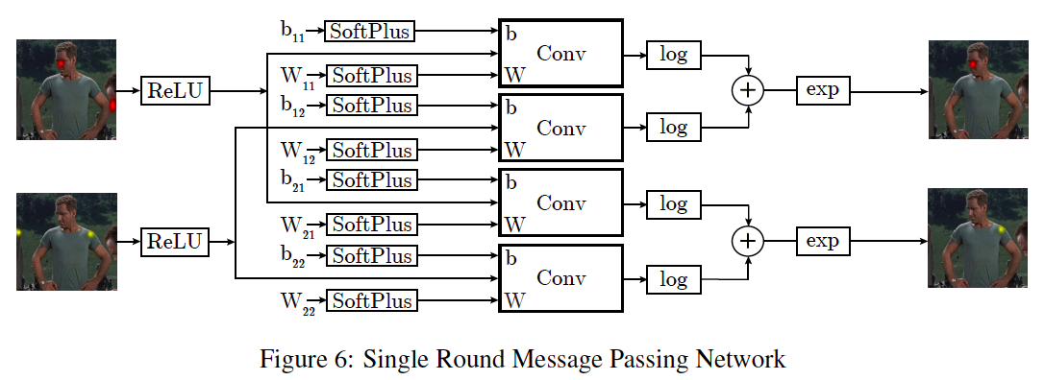

Slide 20
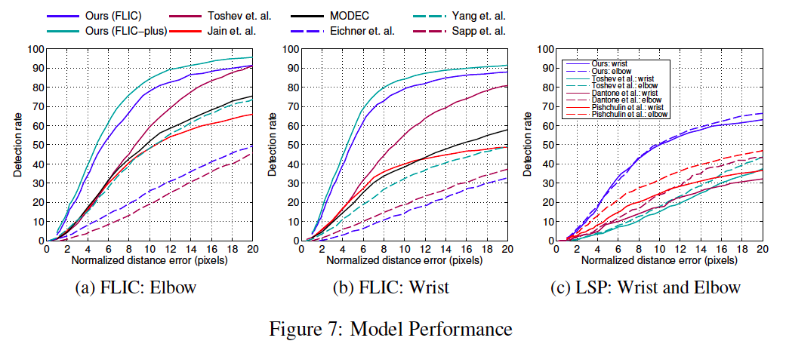

Slide 21
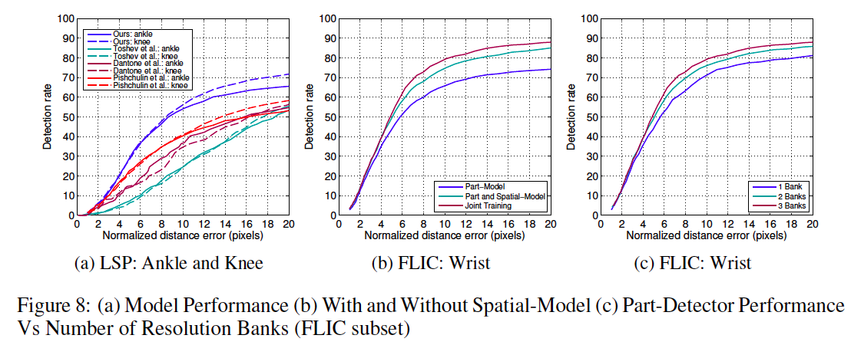

Slide 23
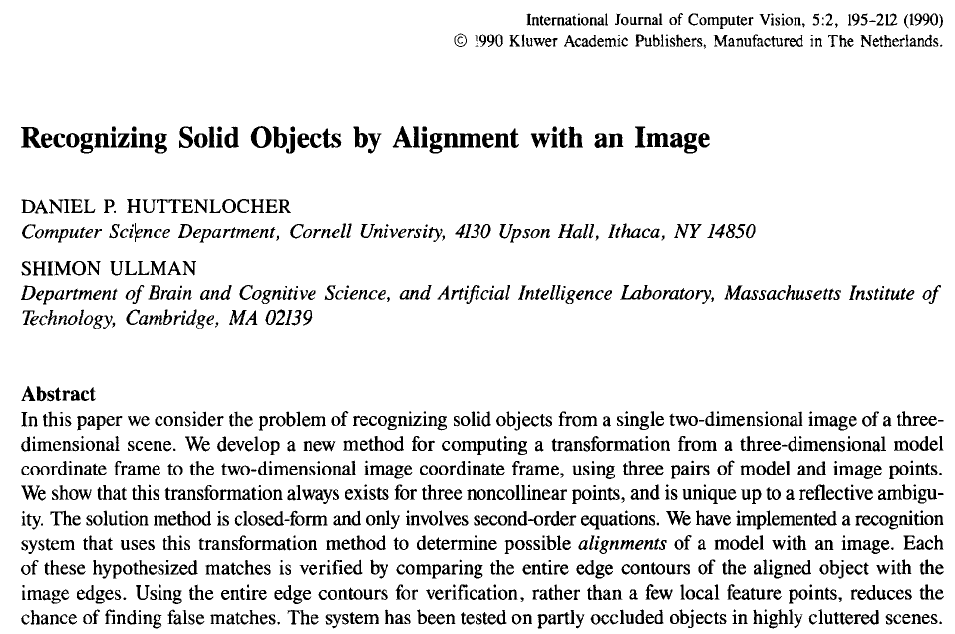

Slide 24
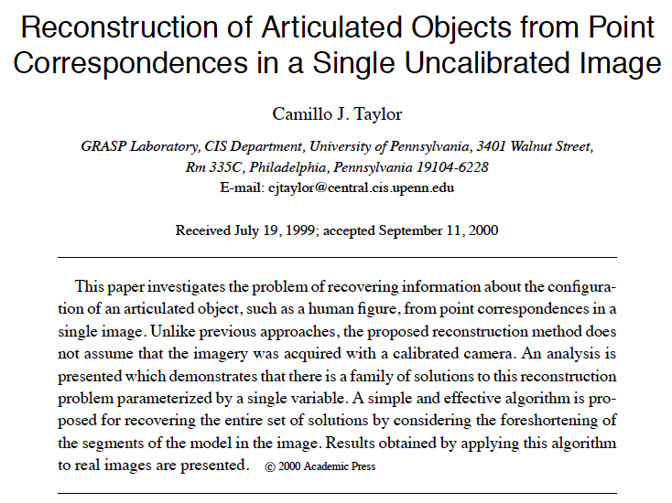

Slide 25
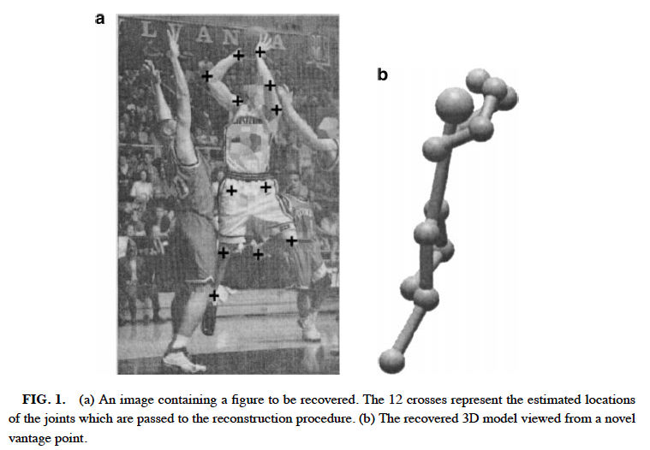
Key observation: Lengths of various body segments are known

Slide 26
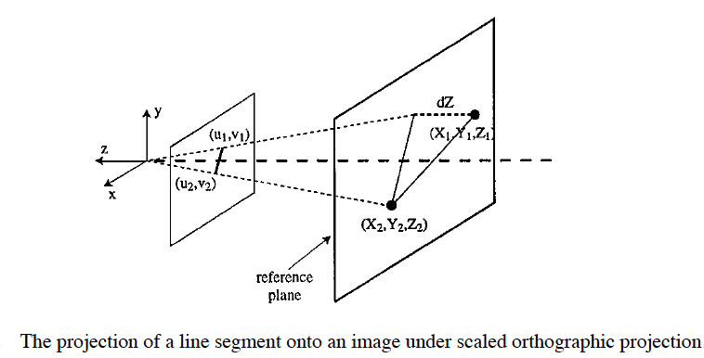
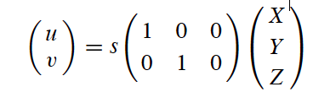
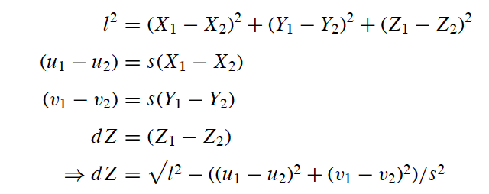

Slide 27
